Slide 1
Coding Master Team’s
Rescuers of the World ™
Antonache Emanuel Adrian – 342 C4 Crețan Bianca Andrada – 341 C4 Jalbă Cristian – 342 C4 Neagu Constantin – 342 C4

Slide 2
Project theme
An online system that can assist individuals in finding missing people, animals or objects by providing specific tools in order to efficiently distribute the effort among all the volunteers or stakeholders.

Slide 3
Storyboard

Slide 4
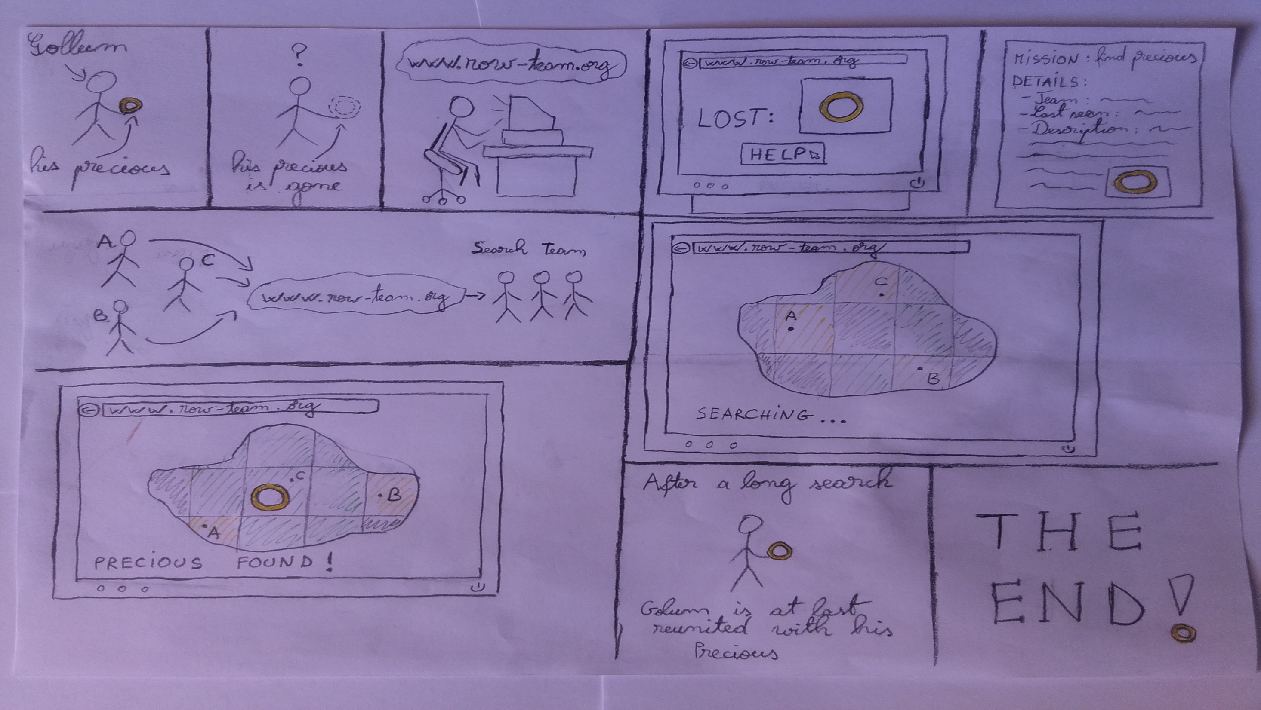

Slide 5
Interface number 1

Slide 6
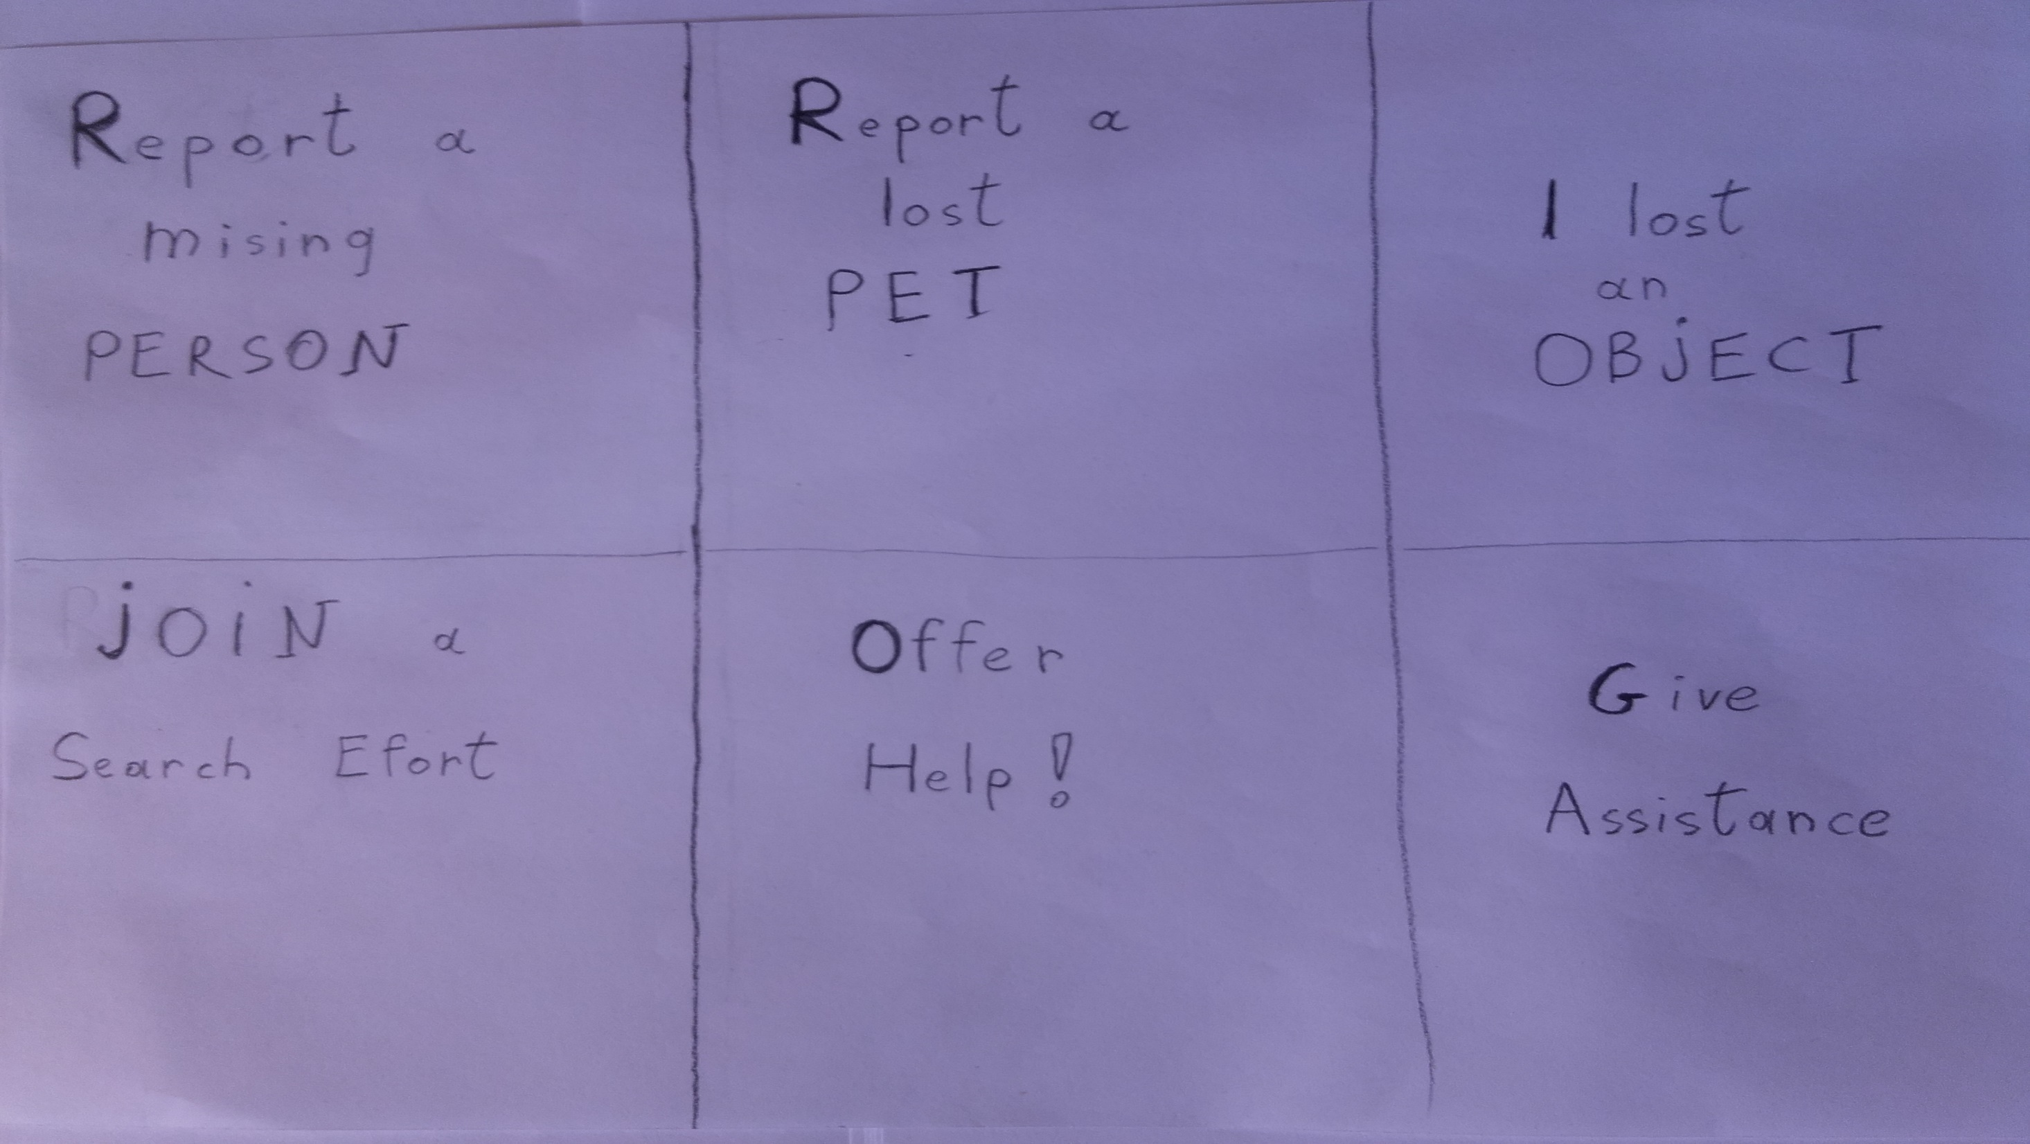

Slide 7
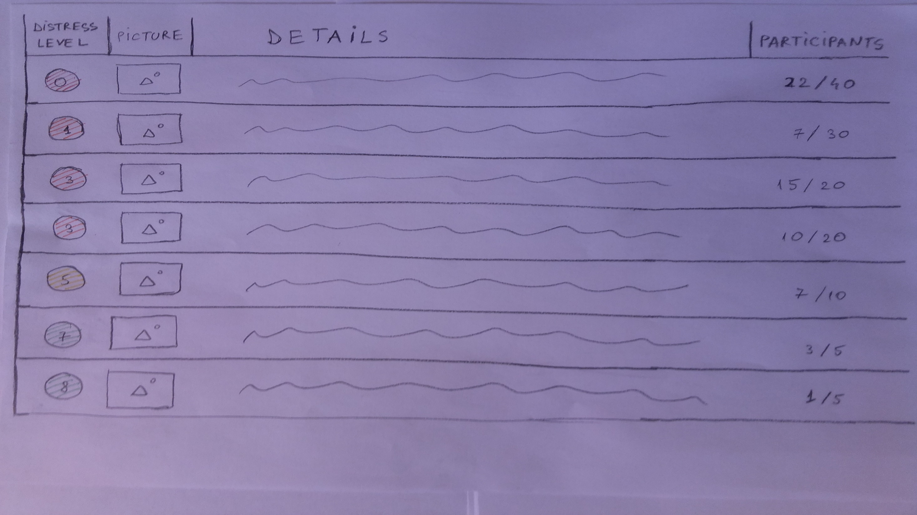

Slide 8
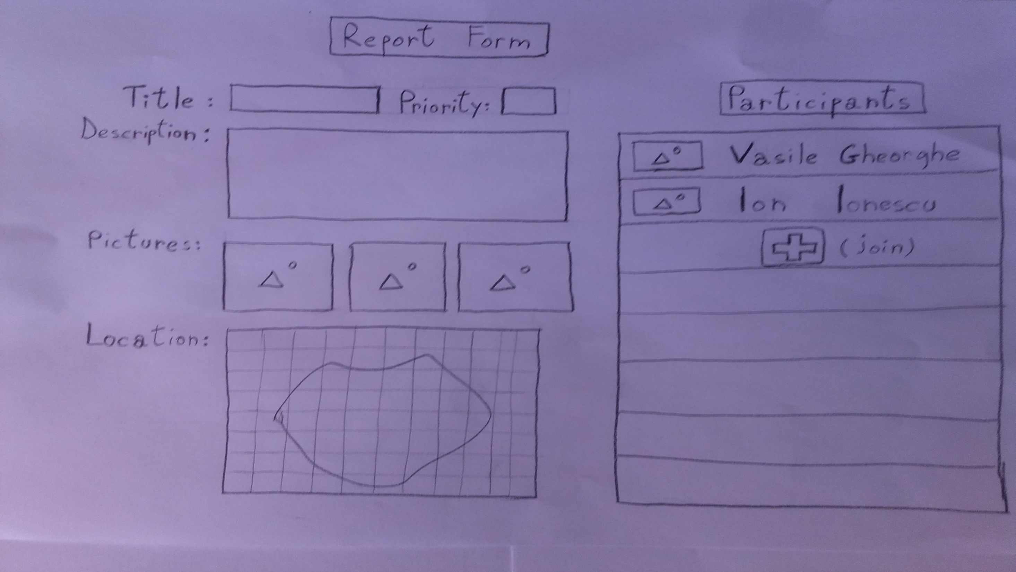

Slide 9
Interface number 2

Slide 10
